Slide 1
Microsoft Azure Web Sites Basics
Microsoft Research
Microsoft Azure for Research Training

Slide 2
Azure Web Sites Basics
Learning objectives – what you will learn:
How to create a simple blog site using Microsoft Azure
An example using the Django (a Python framework), and Bing Maps

Slide 3
Agenda
Microsoft Azure Web Sites Introduction
Publishing methods and frameworks
Scaling choices
Web application gallery
Creating a site – example
Notes:
Slide Objectives:
Introduce the topics that will be covered in this session
VALUE PROP
Speaking Points:
Notes:

Slide 4

Microsoft Azure Web Sites
powerful web sites in seconds
start simple
code smart
go live
start free, scale up and out as you go, friction-free and without the headaches
with classic asp, asp.net, php or node.js, develop on Windows, OSX or Linux
deploy live in seconds, easily monitor performance, rapidly diagnose and fix issues
Notes:
Slide Objectives:
Explain how Microsoft Azure websites are simple, easy, and open.
Notes:

Slide 5





Supported Publishing Methods
FTP://
TFS
WebDeploy
Mercurial
DropBox
Web
Matrix
Xpat-cli
Powershell
Notes:
You have many options for deploying your own content to an Azure Web site. This topic provides a brief overview of each option and links to more information.
Deploying from a cloud-hosted source control system
Visual Studio Online (VSO)
Repository web sites using Git
Repository web sites using Mercurial
Dropbox
Deploying from an IDE
Visual Studio
WebMatrix
Deploying by using an FTP utility
Deploying from an on-premises source control system
Team Foundation Server (TFS)
On-premises Git or Mercurial repositories
Using command-line tools and the Azure REST management API
MSBuild
FTP scripts
Windows PowerShell
.NET management API
Cross-platform command line (xpat-cli)
Web Deploy command line

Slide 6






Supported Web Frameworks
Or any custom FastCGI Handler
Notes:
Slide Objectives:
Explain that Microsoft Azure Web Sites supports Classic ASP, ASP.NET, PHP, and Node.js out of the box and that you can also host any custom FastCGI handler.
Notes:

Slide 7

Scale – three choices
Free
Multi-tenant. Daily quotas.
Shared
Multi-tenant. Daily quotas.
Standard
Dedicated VMs. No quotas.
Notes:
Slide Objectives:
Explain the three scale choices on Microsoft Azure Web Sites.
Notes:
Both free and shared are the same architecture. With standard you isolate your application to your own virtual machines that you can use and pay for whatever resources you choose.
Online Resources:
If you’d like more details on Web Site pricing and quota, see the Microsoft Azure pricing page here: http://www.windowsazure.com/en-us/pricing/details/web-sites/

Slide 8


web sites
shared
standard
1
shared
Shared instances
:-)
Notes:
Slide Objectives:
Explain how you can start with a small site hosted for free.
Notes:

Slide 9
web sites
shared
standard
2
shared
Shared instances
:-)
:-)
Notes:
Slide Objectives:
Explain how you can scale your site to multiple shared instances.
Notes:

Slide 10

web sites
shared
standard
1
0
standard
Shared instances
Standard instance
:-)
:-)
:-)
Notes:
Slide Objectives:
Explain how you can move to standard instances for additional scale.
Notes:

Slide 11
web sites
shared
standard
2
standard
Standard instance
Standard instance
:-)
:-)
Notes:
Slide Objectives:
Explain how you can scale up standard instances to multiple instances as needed.
Notes:

Slide 12


web sites
shared
standard
2
standard
Standard instance
Standard instance
:-)
:-)
:-)
:-)
:-)
:-)
:-)
:-)
Notes:
Slide Objectives:
Explain how you can host multiple sites that you own on a your standard instances.
Notes:

Slide 13
Scaling
Illustration
Notes:
Demo

Slide 14
auto-scaling
standard
CPU utilization
Standard instance
Standard instance
Standard instance
:-)
:-)
:-)
Notes:
Slide Objectives:
Explain how you can host multiple sites that you own on a your standard instances.
Notes:

Slide 15






































Microsoft Azure Web App Gallery
Ready-to-Go Open Source
Web Applications,
Frameworks,
and Templates
Notes:
Slide Objectives:
Highlight the ability to get started quickly with the Microsoft Azure Web App Gallery
Speaking Points:
Along-side the publishing capabilities, Microsoft Azure Web Sites also offers the Web App Gallery which provides many turn key solutions based off of well known open source web applications.
Notes:

Slide 16
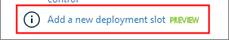
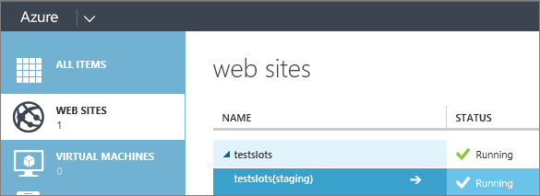


Staged Deployment
Development or Staging site slot for each standard production site.
Validating before deployment
Building and integrating site content
Rolling back a production site.
No downtime, seamless traffic redirection, no request dropped.

Slide 17
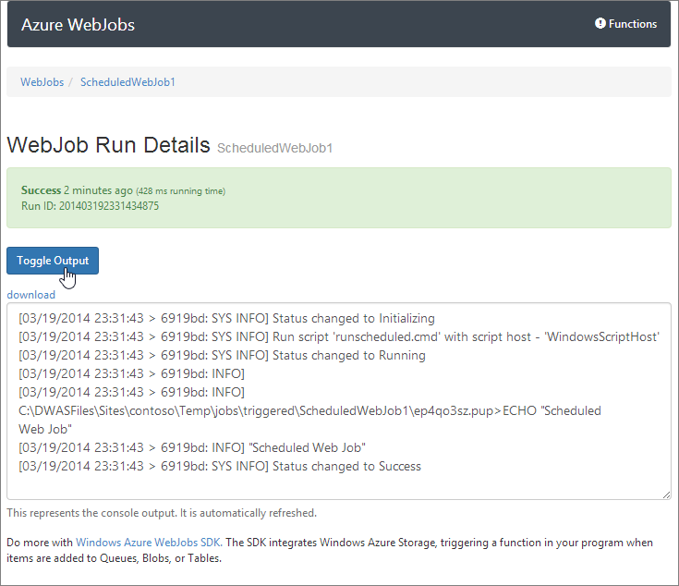
WebJobs
Run programs or scripts in web sites.
.cmd/.bat/.exe/.ps1/.sh/.php/.py/.js
on demand/continuously/on a schedule
WebJob History
Microsoft Azure WebJobs SDK

Slide 18
Creating a Wordpress site
HOL
Notes:
Do this as a demo, and make the lab optional. Only if people want to follow along.

Slide 19
Lab: Creating a Django Website
HOL
Notes:
o If attendees are using a Mac and cannot upload content to the FTP using FileZilla, make sure they remove the "ftp://" from the host name.

Slide 20
Websites Basics
Learning objectives – what we have learned:
How to create a simple blog site using Microsoft Azure
An example using the Django (a Python framework), and Bing Maps

Slide 21
Application Scenarios
Web Sites
Cloud Services
Virtual Machines
Modern web apps
Perfect if your app consists of client side markup and scripting, server side scripting and a database. Powerful capability to scale out and up as needed.
Multi-tier applications
Cloud-based applications that separate application logic into multiple tiers (i.e. caching middle tier, asynchronous background processes like order processing) using both Web and Worker Roles
Enterprise server applications
Run your existing enterprise applications in the cloud, such as SQL Server, SharePoint Server or Active Directory.
Continuous development
Deploy directly from your source code repository, using Git or Team Foundation Service.
Apps that require advanced administration
Cloud-based applications that require admin access, remote desktop access or elevated permissions
Porting existing line of business apps
Choose an image from the library or upload your own VHD.
Popular open source apps
Launch a professional looking site with a few clicks using apps like WordPress, Joomla!, Drupal, DotNetNuke and Umbraco
Apps that require advanced networking
Cloud-based applications that require network isolation for use with Microsoft Azure Connect or Microsoft Azure Virtual Network
Windows or Linux operating system
Support for Windows Server, along with community and commercial versions of Linux. Connect virtual machines with cloud services to take full advantage of PaaS services.
Notes:
Leave in appendix for QA when the question is asked.

